Slide 1

Travelers Case Competition
Anushri Dixit
Arkojyoti Hore
Dnyanesh Kulkarni
Mansi Bodke
Neeraj Subhedar

Slide 2
Agenda
Executive Summary & Problem Definition
EDA results
Modeling approach
Business impact of the model- Customer segmentation criteria
New variables proposed
Future work

Slide 3
Executive Summary
Use of predictive modeling in insurance domain
Business benefits
Brief results of the analysis
Cost Benefit Analysis and Value-Add

Slide 4
Problem Definition
Predict the claim-cost using given variables
Business use case
Target variable: ‘claim cost’
Data description

Slide 5
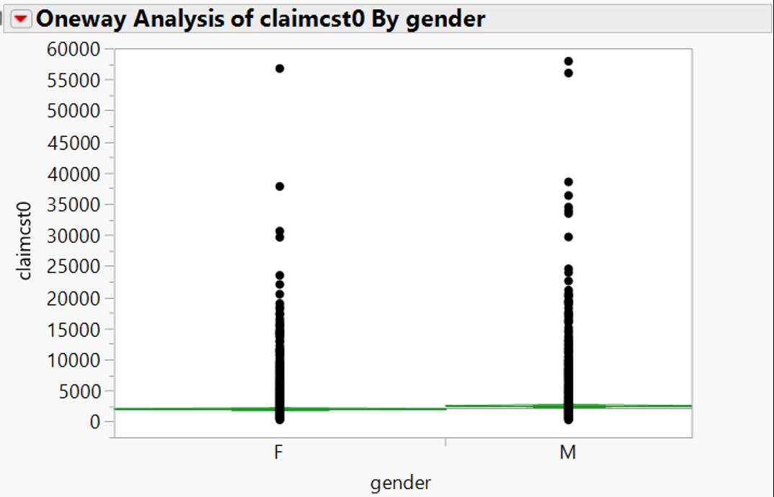
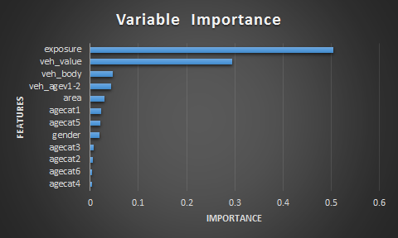
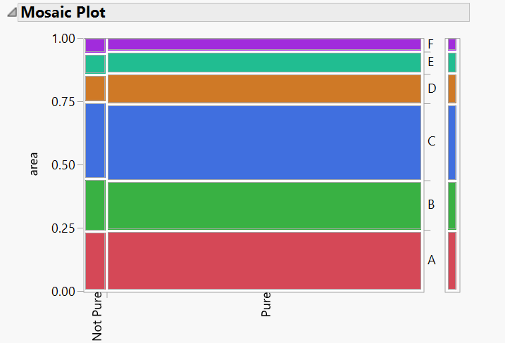
Approach : EDA + Modeling

Slide 6
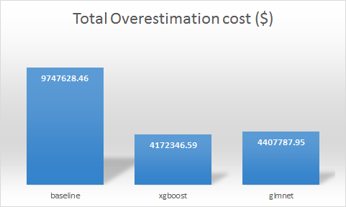
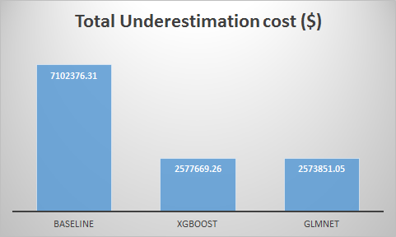
Approach : EDA + Modeling
Glmnet
- Performed better than other generalized linear models in terms of accuracy and gini index
- Gini index: 0.205 (on validation data)
-
Xgboost
- Highly sophisticated
- Can tackle various data irregularities
- Parallel processing
- Gini index: 0.2124 (on validation data)
- Efficient implementation of regularized boosting
- Fits various distributions like Poisson, gamma, inverse Gaussian, etc.
- Implements optimal combination of both lasso and ridge regularizations

Slide 7
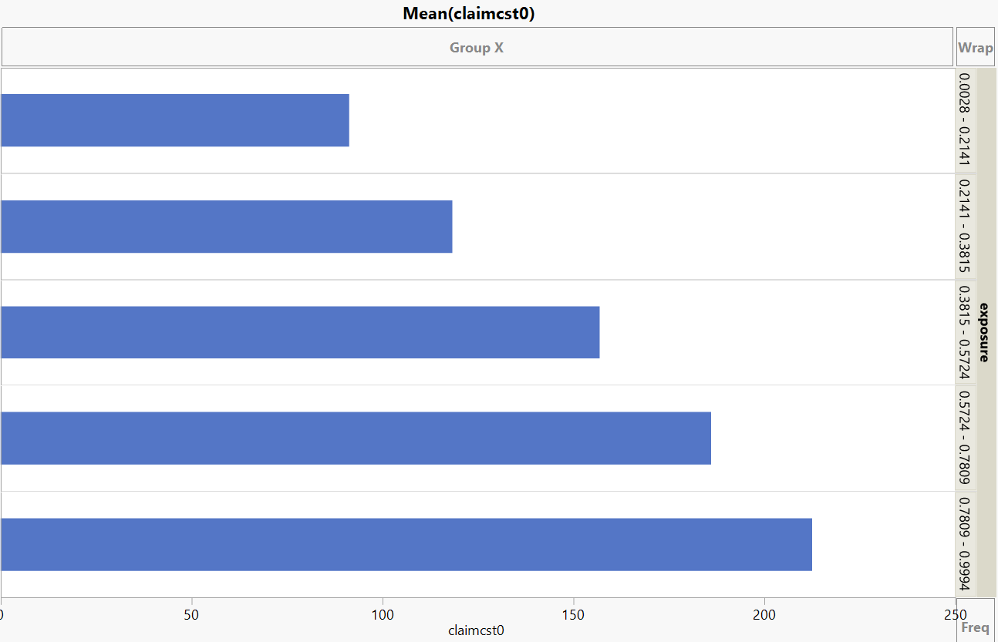
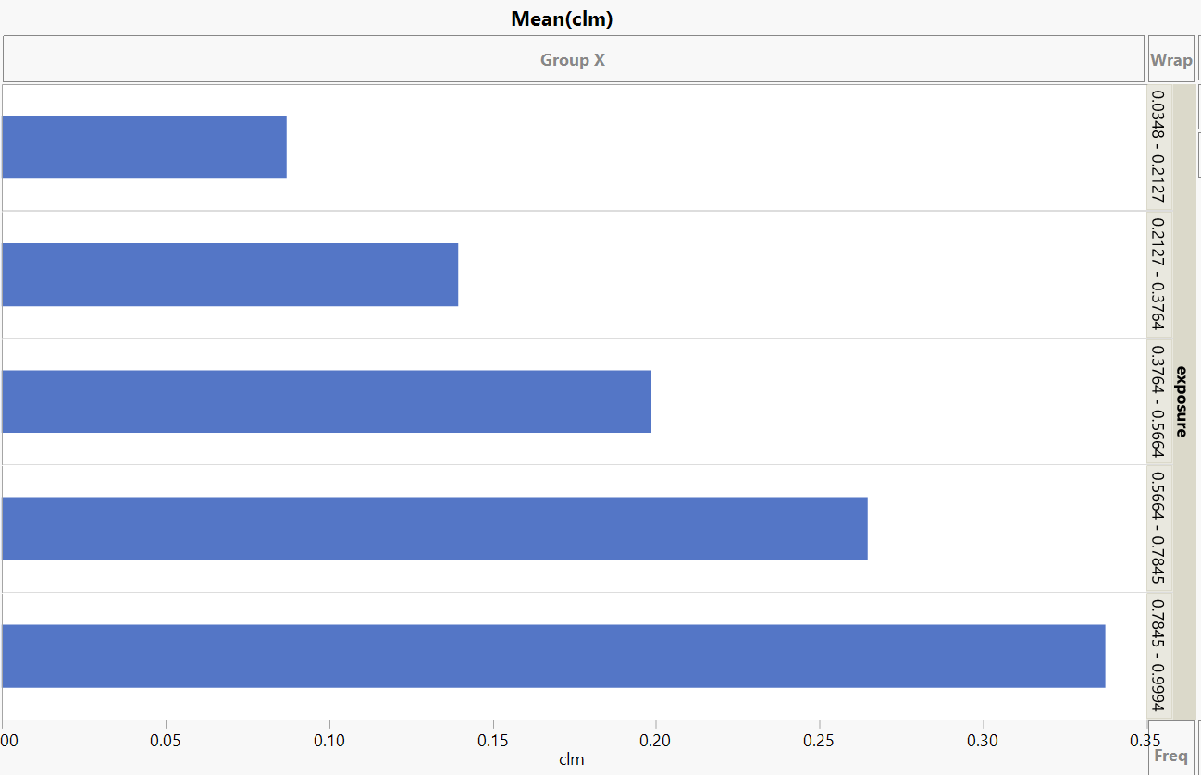
Customer Segmentation
Exposure v/s Claim Cost
Train and Validation
Hold

Slide 8
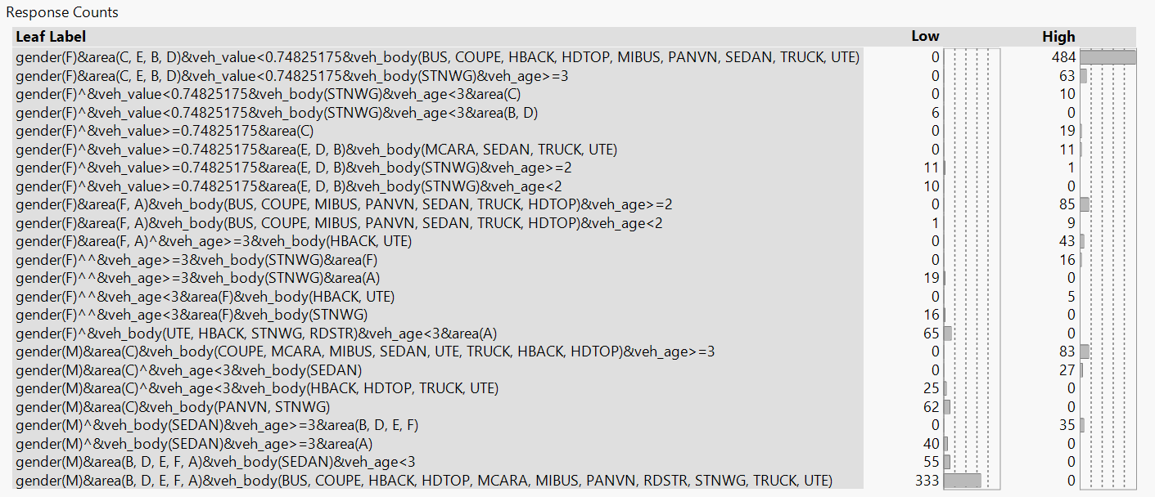
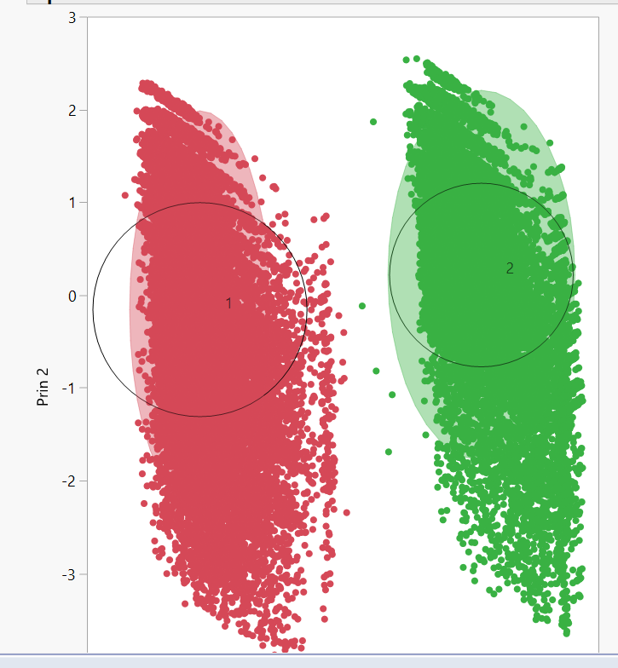
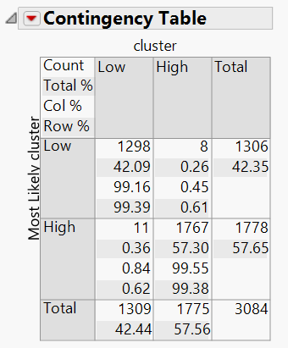
Customer Segmentation

Slide 9

Potential Variables
Claim History
Customer Credit Information
Miles Traveled
Automobile Details
Drive History
Policy Information
- Claim time
- # of Claims
- Policy Type
- Amount Refunded
- Debts
- Payment history
- Driver Rating
- Medical History
- Alcohol consumption
pattern
- Efficiency
- Purpose of use
- Miles Travelled

Slide 10
Future Work
Adding newly proposed variables and re-modeling
Cost predictions for different segments
Re-categorization of the variables from observed trends for better results
Trying new models based on the distribution of the target variable

Slide 11
Thank you !

